Slide 1
The Point of This Course
CS 5010 Program Design Paradigms “Bootcamp”
Lesson 0.1
© Mitchell Wand, 2012-2015
This work is licensed under a Creative Commons Attribution-NonCommercial 4.0 International License.
Notes:
Welcome to CS 5010, Program Design Paradigms, also known as “Bootcamp”
I’m Professor Wand, and I will be your instructor in this online course.
In this lesson, we will learn about the goals of this course and about some of the educational philosophy behind it.

Slide 2
Learning Objectives
By the time you complete this lesson, you should be able to :
Explain the point of the course
list the 7 principles for writing beautiful programs
list the 6 steps of the design recipe
recite some of the slogans that we will use throughout the course.

Slide 3
The Point
1. It’s not calculus. Getting the right answer is not enough.
2. The goal is to write beautiful programs.
3. A beautiful program is one that is readable, understandable, and modifiable by people.

Slide 4
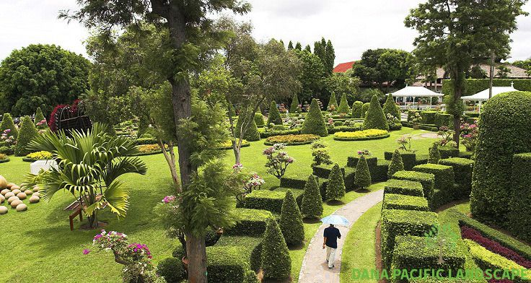
Your programs should look like this:
source

Slide 5
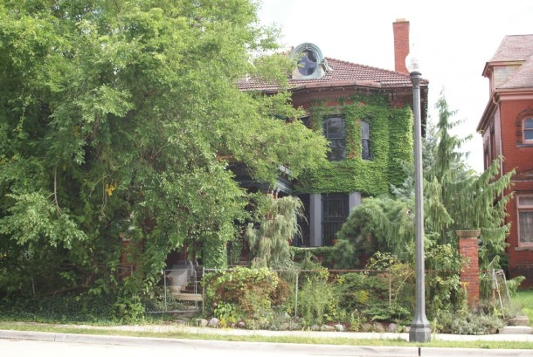
Not like this
source

Slide 6
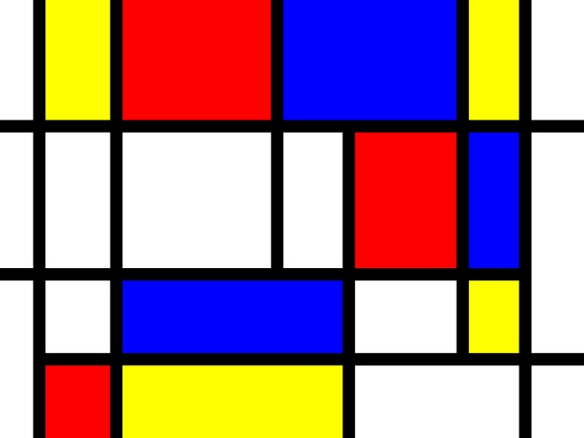
Your programs should look like this
source

Slide 7
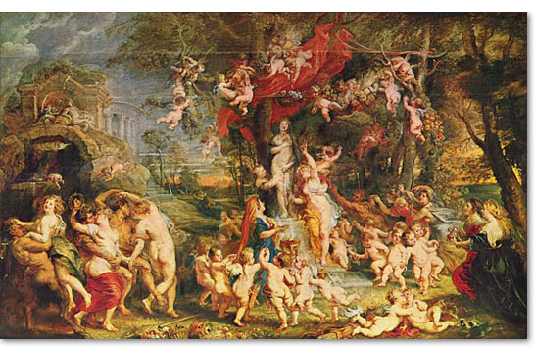
Not like this
source

Slide 8
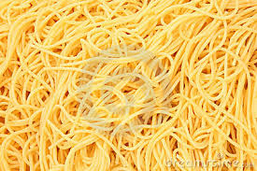
And never, ever like this
source

Slide 9
Seven Key Practices for Writing Beautiful Programs
1. Write programs that people can read, understand, and modify.
2. Represent information as data; interpret data as information.
3. Use contracts and purpose statements to specify the intended behavior of your functions and methods.
4. Use invariants to limit your functions’ responsibility.
5. Use functions and methods that communicate by passing arguments and returning values
6. Use global side-effects only to share information between distant parts of the program.
7. Use interfaces to limit dependencies between different parts of your program.

Slide 10
The Key Practices in Action
Everything we do can be traced back to one or more of these key practices.
We will expand on each of them as we go along.
Write these down, in your own handwriting. Writing things down will help you remember them.

Slide 11
The Function Design Recipe
This recipe tells you the order in which to attack a programming problem.
You need to do these steps in order:
If you haven’t specified your data, you won’t know what your data looks like or what it means.
You can’t write a function that does its job unless you know what its job is.

Slide 12
The Function Design Recipe
1. Data Design
2. Contract and Purpose Statement
3. Examples and Tests
4. Design Strategy
5. Function Definition
6. Program Review
This is important. Write it down, in your own handwriting. Keep it with you at all times. Put it on your mirror. Put it under your pillow. I’m not kidding!
Notes:
Here is the function design recipe.

Slide 13
A Few of Our Slogans
We are also big on slogans. We think they help focus your mind.
Here are our first few slogans. You should write them down, too, in your own handwriting.
In fact, whenever you see one of these blue tables, you should assume that this is something important, and you should probably write it down in your own handwriting so you can memorize it.

Slide 14
Some Slogans
1. Follow the recipe!
2. You don't understand it until you can give an example.
3. One function, one task.
4. The Shape of the Data Determines the Shape of the Program.
5. Practice makes perfect.

Slide 15
The Course Map
The course is divided into 3 main units:
Basic Principles
Tools and Techniques
Object-Oriented Programming
The first unit is taught in Racket; the second in a mixture of Racket and Java; and the third in Java.
The map on the next slide, which we will show at the beginning of every module, will help you see where you are in the course content.

Slide 16
Course Map
Tools and Techniques
Object-Oriented Programming
Designing Data
Designing Functions
Designing Systems
Computing with Lists
Computing with Trees and Graphs
Designing with Invariants
Thinking about Efficiency
Interfaces and Classes
Inheritance
Objects with Mutable State
Efficiency, Part 2
Basic Principles
Computing with Higher-Order Functions

Slide 17
Course Map
Tools and Techniques
Object-Oriented Programming
Designing Data
Designing Functions
Designing Systems
Computing with Lists
Computing with Trees and Graphs
Designing with Invariants
Thinking about Efficiency
Interfaces and Classes
Inheritance
Objects with Mutable State
Efficiency, Part 2
Basic Principles

Slide 18
Next Steps
If you have questions about this lesson, ask them on Piazza
Go on to the next lesson

